Slide 1
Progress Report
Basis Technology
Kratika Agrawal, Vandana Anand, Xinlu He, Min Huang, Soumya Joshi, Jing Yu

Slide 2

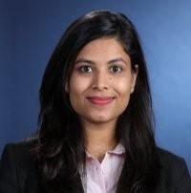




Project Team Introduction
Sponsors & Mentors
Gil Irizarry Kfir Bar
Vice President - Engineering Chief Scientist
gil@basistech.com kfir@basistech.com
Team Members
Vandana Anand vanand@wpi.edu 978-427-5212 | Kratika Agrawal kagrawal@wpi.edu 774-701-9288 | Jing Yu jyu5@wpi.edu 608-886-8578 | Soumya Joshi sjoshi2@wpi.edu 508-615-8354 | Min Huang mhuang3@wpi.edu 774-253-5410 | Xinlu He xhe4@wpi.edu 774-253-8221

Slide 3

Project Goal
Goal: Improve BT’s current entity linking tool Rosette by applying a novel model to increase entity linking performance.
Current Stage: Implement three entity linking models based on research papers.
Notes:
Rosette is a text analytics tool used to extract entities from large amounts of text, specifically nouns such as a person, place, time, etc

Slide 4
Previous weeks’ accomplishments
Latent Relations Model
Completed calculating the prior possibility using latest version wikipedia KB
Tested the latent model
End to End Model
Preprocessing AIDA dataset and understanding the steps required for the BT data
Training/Testing AIDA dataset as well as training other datasets (ex. Wikipedia)
Comparing scores among other models
DeepType Model
Divided the work into two approaches
Run Github module on AIDA dataset
Transform AIDA dataset to trainable format and continue training and evaluation

Slide 5
Latent Relations Model

Slide 6
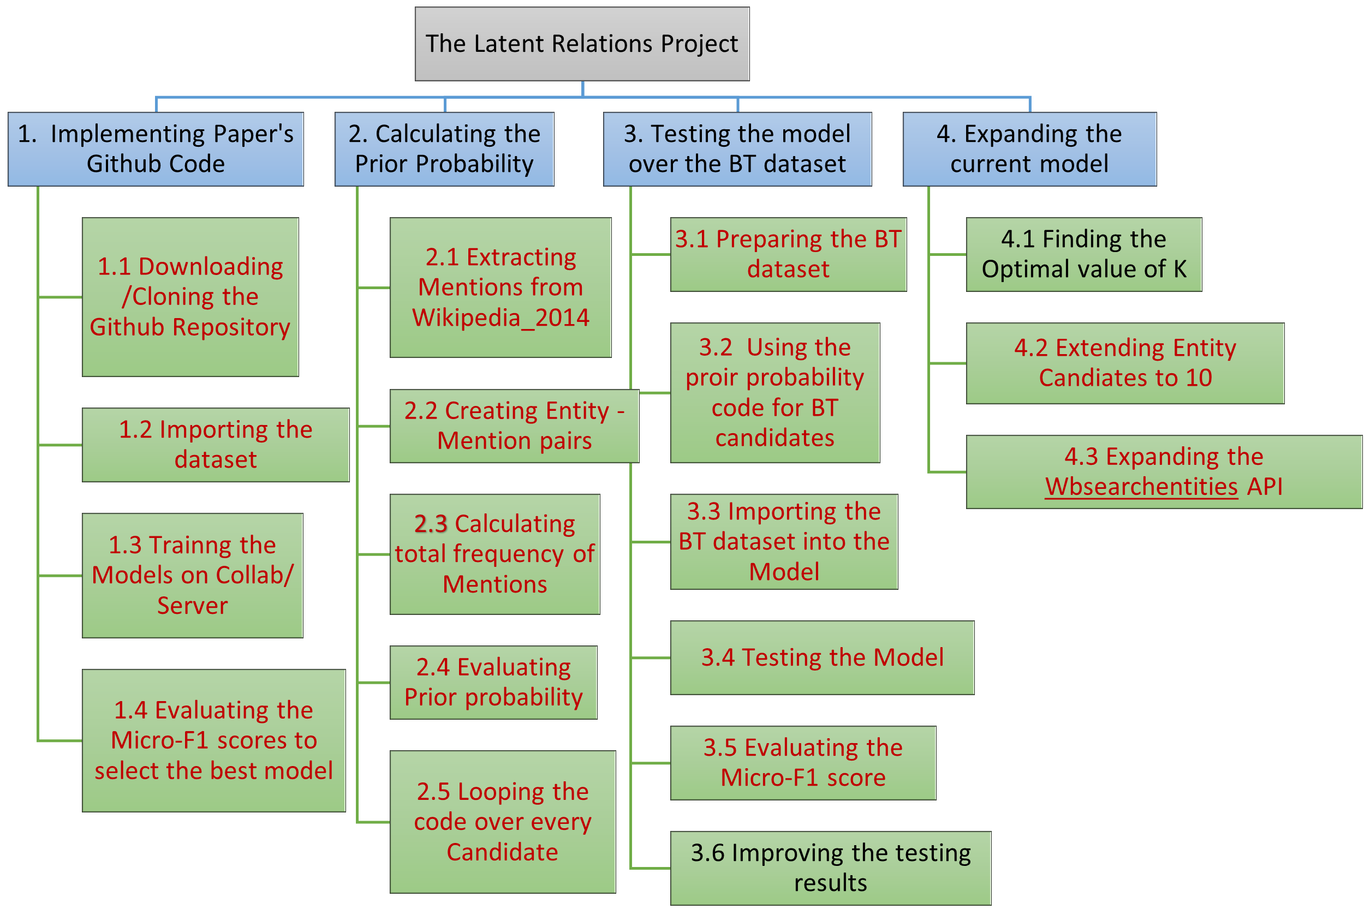
Work Breakdown Structure
Tasks left to do
Latent Relations Project
3.Testing the model over BT dataset
3.6 Improving the testing results
4. Expanding the current model
4.1 Finding the optimal value of k

Slide 7
Prior Probabilities
Get the latest version wikipedia KB
Download English Wikipedia xml dump
Applied wikiextractor to get articles
Applied unquote() to transform URL strings to normal strings
e.g. Séamus O\'Doherty (11 June 1882 - 23 August 1945) was an <a href="Irish republicanism">Irish republican</a>.\n\nSéamus O\'Doherty was born on 11 June 1882 in <a href="Derry">Derry</a>.

Slide 8
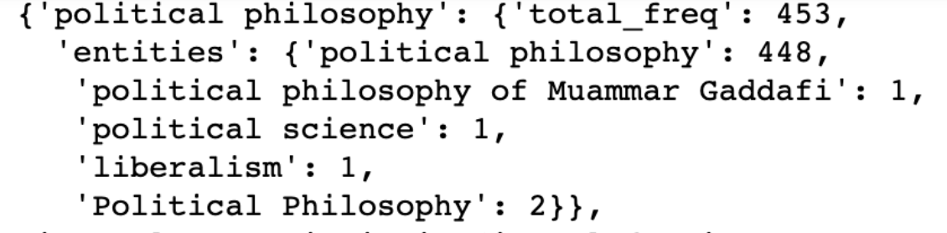
Prior Probabilities
Calculating prior probability
[mention,entity] Frequency: The times that the mention linked to the entity in Wikipedia KB
P(e|m) = [mention,entity] Frequency / All the [mention, entity] pairs Frequency for each mention
Frequency.json Format:
data[mention] = {‘total_freq’: counts, ‘entities’:{‘entity1’:counts,’entity2’:counts}}
e.g. data:

Slide 9
Generate bt dataset
Integrate with BT data
Entities selection is based on wiki API
Could not find corresponding frequency data in frequency.json file
Solution:
Select candidates directly based on wikipediatextfile
Extract Entities from the frequency.json
Normalize the mention (lower(), re.sub)
Got 128 mentions have less than 10 candidates
Generate new mentions e.g. “air marshal service” to “air marshal”
Integrate frequency with the old mentions
Remove 41 mentions

Slide 10
Final dataset
Input BTdataset Format:
{‘mention’, ‘context’:[leftctx,rightctx], ‘candidates’:[entityname, priorprob], ‘gold’, ‘conll_doc’:{ ‘sentences’: splitted lists of sentences in the article, ‘mentions’: the position of all the mentions in the list}, ‘conll_m’: the position of each mention in the list}
e.g. {"1.json": [{"mention": "United States", "context": ["A ", " federal air marshal shot dead on Wednesday an American Airlines passenger named Rigoberto Alpizar on American Airlines Flight 924 a Boeing 757 at Miami International Airport in Miami Florida USA …. three shots"], "gold": ["United States of America", 1e-05, -1], "candidates": [["United States", "0.944"], ["United States men's national soccer team", "0.009"], ["United States of America", "0.007"], ["United States women's national soccer team", "0.004"], ["United States national rugby union team", "0.002"], ["United States men's national ice hockey team", "0.002"], ["Secondary education in the United States", "0.002"], ["United States national rugby league team", "0.001"], ["United States men's national basketball team", "0.001"], ["United States national cricket team", "0.001"], ….."conll_doc": {"sentences": [["A", "United", "States", "federal", "air", "marshal", "shot", "dead", "on", "Wednesday", "an", "American", "Airlines", "passenger", "named", "Rigoberto", "Alpizar", "on", "American", "Airlines", "Flight", "924", "a", "Boeing", "757", "at", "Miami", "International", "Airport", "in", "Miami", "Florida", "USA"], ["The", "44yearold", "passenger", "ran", "out", "of", "the", "door", "of", "the", "airplane", "after", "he", "reboarded", "the", "plane", "following", "a", "customs", "check", "in", "Miami"], ["He", "was", "intercepted", "by", "the", "marshals", "before", "reaching", "the", "jetway", "and", "told", "to", "get", "on", "the", "ground"], ["According", "to", "Air", "Marshal", "Service", "spokesman", "Dave", "Adams", "the", "passenger", "did", "so", "but", "then", "reached", "for", "a", "bag", "at", "which", "point", "a", "marshal", "fired", "two", "or", "three", "shots", "and", "killed", "the", "passenger"], ["The", "passengers", "recall", "that", "they", "heard", "up", "to", "six", "shots"],......], "mentions": [{"sent_id": 0, "start": 1, "end": 2}, {"sent_id": 0, "start": 11, "end": 12}, {"sent_id": 0, "start": 15, "end": 16}, {"sent_id": 0, "start": 11, "end": 12}, {"sent_id": 0, "start": 23, "end": 24}, {"sent_id": 0, "start": 26, "end": 28}, ……….]}, "conll_m": {"sent_id": 0, "start": 1, "end": 2}},

Slide 11
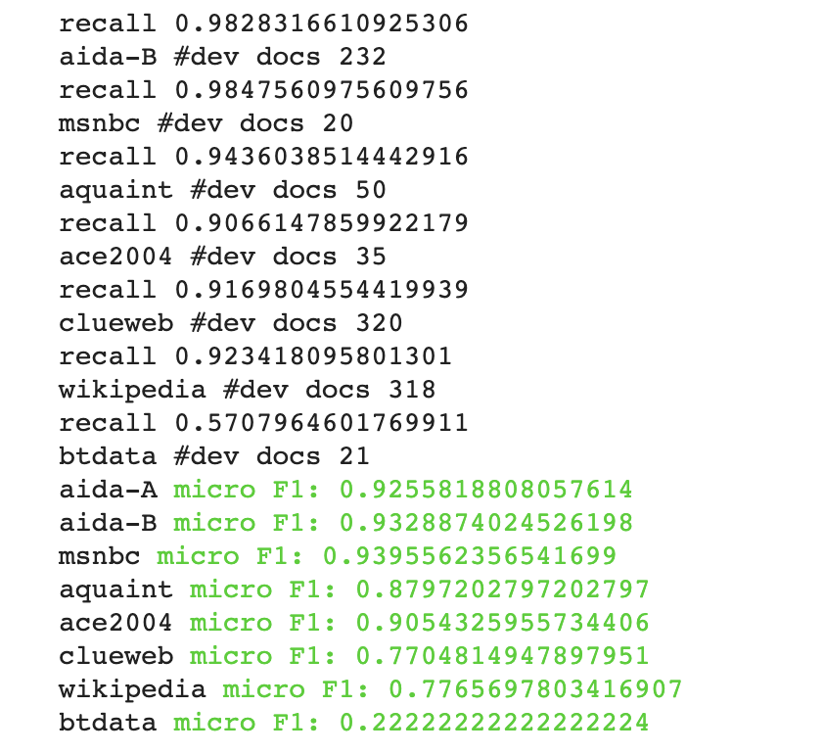
Testing result
Reasons might be:
BT dataset is too small (only 21 docs)
Transformed mentions when selecting candidates and calculating their frequency
Neglect some errors when processing the bt dataset
Other reasons related to the model
Next steps:
Find errors and improve the bt testing result

Slide 12
End2End Model
Notes:
The End to End model includes Mention Detection(MD) and Entity Disambiguation(ED)

Slide 13
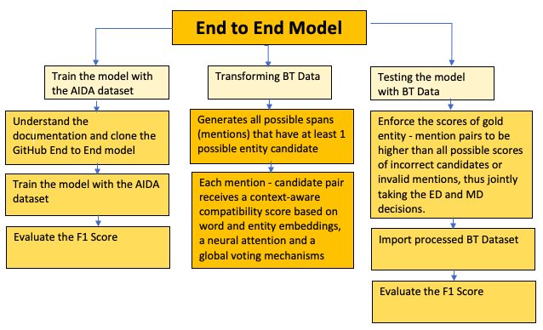
Workflow

Slide 14
End to End Model
Done
Preprocessing AIDA dataset and understanding the steps required for the BT data
Training/Testing AIDA dataset as well as training other datasets (ex. Wikipedia)
Comparing scores among other models
In Progress
Transforming BT Dataset
Testing
Next Step
Improve accuracy scores and BT’s model

Slide 15
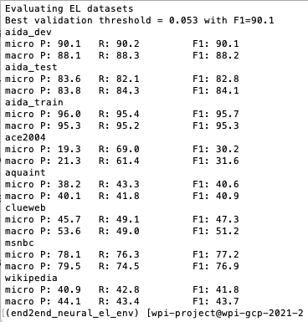
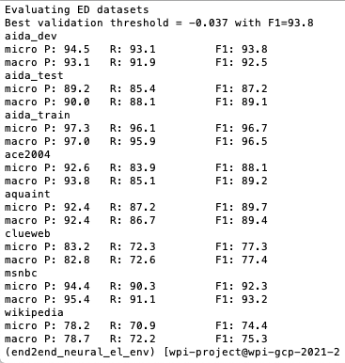
Training
Entity Linking Training
Entity Disambiguation Training
Model
Performance
Notes:
ED performed a lot better than EL especially for the Wikipedia dataset
The training model on different datasets for both EL and ED performed a bit worse overall than the latent model whose wiki training was the lowest performing dataset at 77%. However here, the Wiki dataset is at 74-75% which is lower.
Micro/Macro - For EL, these metrics are computed both in the strong matching and weak matching settings. Micro requires exactly predicting the gold mention boundaries and their entity annotations, whereas Macro gives a perfect score to spans that just overlap with the gold mentions and are linked to the correct gold entities.

Slide 16
Training/Testing AIDA
Entity Disambiguation | Train Score | Test Score | Test Precision | Test Recall
Best Scores | 92.2% | 85.7% | 88.5% | 83%
Entity Linking | Train Score | Test Score | Test Precision | Test Recall
Best Scores | 62.9% | 56.8% | 57.5% | 56.1%
Using all Spans Best Score | 89.1% | 80.1% | 83.5% | 76.9%
Notes:
While processing the BT dataset, we trained and tested the AIDA data to see what we could expect. We used the base model for EL and ED training/testing on the AIDA dataset which ran overnight and obtained these scores. We expect to see similar or lower scores for the BT dataset because it will be smaller. The AIDA dataset has more than 502K data points.

Slide 17
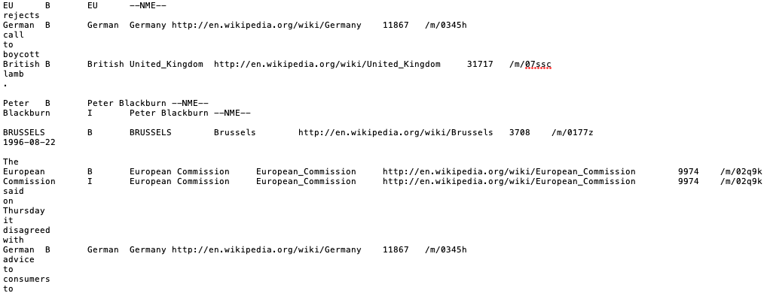
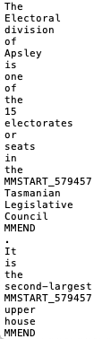
BT data processing
AIDA Dataset Processing
Wikipedia Processing

Slide 18
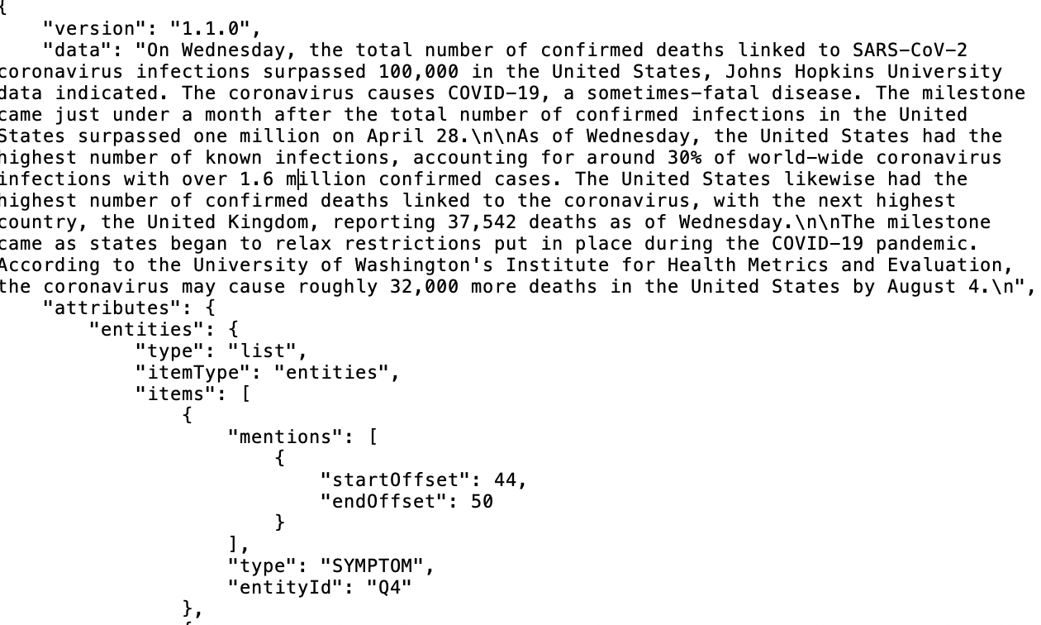
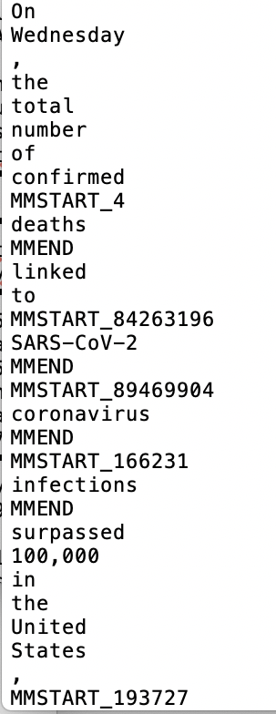
BT data processing

Slide 19
DeepType Model

Slide 20
Major Issues:
Wikidata Entity dataset is larger than expected: 1.5 TB
Wiki english articles dataset: 75 GB
Data pre-processing fails with error for many missing entities: Difficult to handle all missing entities

Slide 21
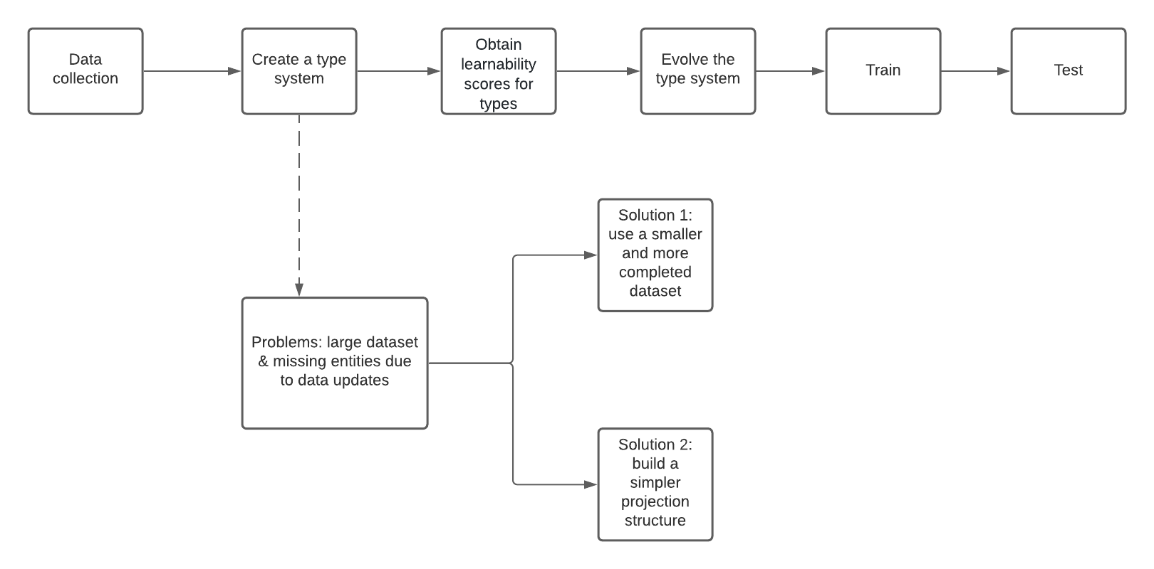
Workflow

Slide 22
Approach 1:
Run Github code on AIDA dataset by querying Wikidata entities instead of downloading entire wikidata entity dataset (1.5 TB)
Before building a type system (assign a type to a mention)
get the categories of the articles where the mentions have appeared
link mentions and possible categories they belong to and build a graph

Slide 23
Approach 1:
Run Github code on AIDA dataset by querying Wikidata entities instead of downloading entire wikidata entity dataset (1.5 TB)
Problems
Getting categories for each article from AIDA dataset
AIDA articles do not include categories information
tried to extract categories using topic model (LDA) but not getting meaningful results
Building the graph between AIDA entities and AIDA articles
some mentions just appear in one article, makes it hard to build a complete graph

Slide 24
Approach 1:
Run Github code on AIDA dataset by querying Wikidata entities instead of downloading entire wikidata entity dataset (1.5 TB)
Two possible ways for future work
returning to wikidata + wiki articles with more dedicated preprocessing (still need to deal with the large dataset)
building a graph between AIDA articles & AIDA entities similar to wikidata & wiki articles

Slide 25
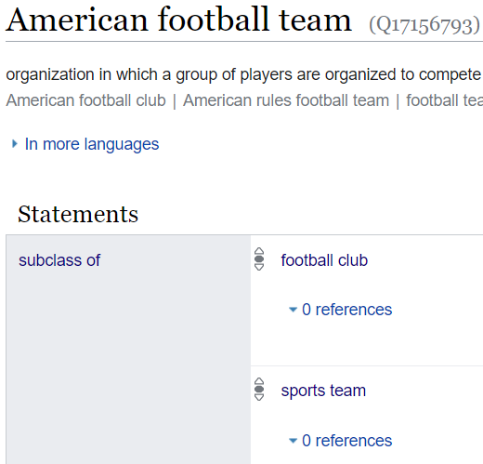
Approach 2:
Create Graph using AIDA dataset mentions’ candidate entities along with their claim details from Wikidata
Obstacles:
created one big knowledge graph using Candidate Entities for each mention in all train text document
simplified type_classifier dataframe to consider few scenarios
Issue in prioritizing relations among all

Slide 26
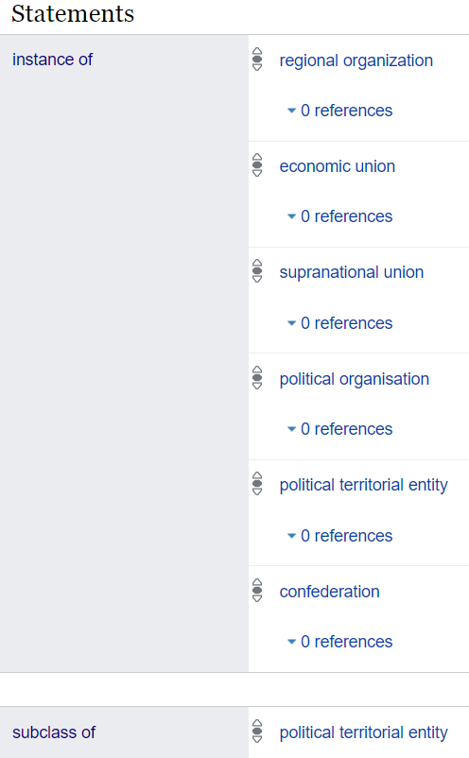
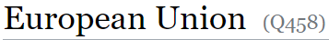
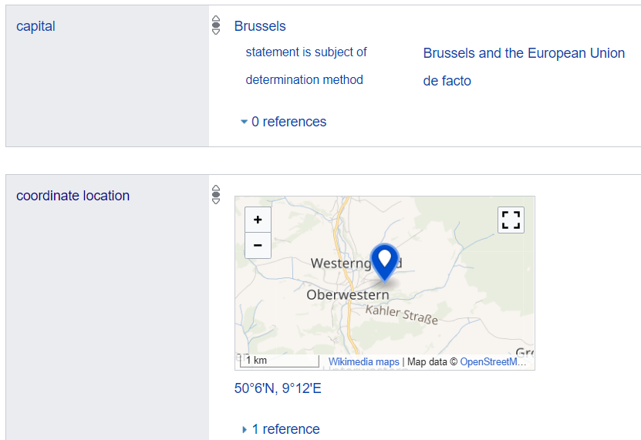
Approach 2:

Slide 27
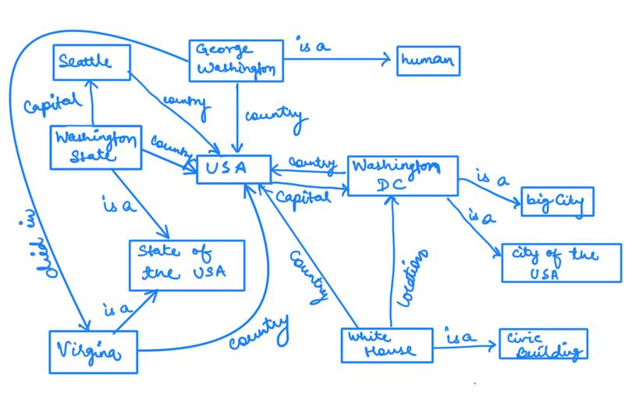
Knowledge Graph:
S1: Washington died in Virginia
S2: Washington has city Seattle
S3: The White House office in Washington

Slide 28
Robust Disambiguation:
Disambiguation Technique that combines three measures:
Prior probability of a mentioned entity
Similarity between the context of the mention to candidate entities
Coherence among candidate entities for all mentions together
These steps will build a weighted graph of mention and candidate entities.
Compute a dense sub-graph that approximates the best joint mention-entity mapping

Slide 29
Prior Probability:
Identify all mentions in a text document
List all candidate entities for each mention using WikiSearchAPI
Prior Probability: a measure of popularity of an entity
Defines the “frequencies” based on Wikipedia link anchor text referring to specific entities.
For each surface form that constitutes an anchor text, count how often it refers to a particular entity: it is an estimate of probability distribution over candidate entities.
Eg: “Kashmir” refers to Kashmir (the region) in 90.91% of all occurrences, in 5.45% to Kashmir (Song).

Slide 30
Context Similarity:
Two approaches:
For each mention, construct a context from all words in the input text.
It represents mention as set of weighted words or phrases
Consider similarity score based on syntactically-parsed context
Associate each entity with characteristic key phrases or words.
Eg: “Page”
Larry Page: keyphrases like “Stanford”, “search engine”, etc.
Jimmy Page: keyphrases like “Gibson guitar”, “hard rock”, etc.
Compute similarity measure between a mention and entity candidates.
Additionally, use syntactic contextualization technique, based on dependency trees, that suggests phrases that typically co-occur.

Slide 31
Coherence among Entities:
Quantify the coherence among two entities by the number of incoming links that their Wikipedia articles share.
It’s based on the notion that entities that co-occur in a text document have some semantic relationship or have the same semantic type.
Eg: Most texts deal with a single or few semantically related topics, like, rock music, internet technology or global warming

Slide 32
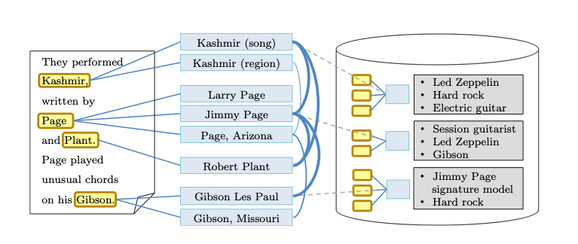
Graph Modelling:

Slide 33
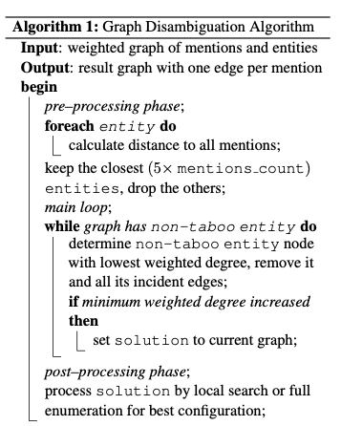
Graph Algorithm:

Slide 34
Difficulties
The testing result of BT dataset is not good
Large data files and not enough space
Documentation to run models are bit confusing and require other installation packages
Issue running DeepType model
Learning a new neural graph algorithm

Slide 35
Contribution
Soumya | Testing the latent model Workflow Summary
Min | Testing the latent model Calculating the prior probabilities Generating the final BT dataset
Vandana | Training/Testing End to End Model Workflow Diagram
Xinlu | Transforming BT’s data to format used in End2End code Implementation Timeline
Kratika | DeepType model Approach 2 implementation Converting document tokens to documents Getting an understanding of Robust Disambiguation model
Jing | DeepType model Github implementation Extracting Wikidata entities corresponding to Wikipedia Entities Extracting candidate entities Formatting AIDA data to format used in deepType code

Slide 36
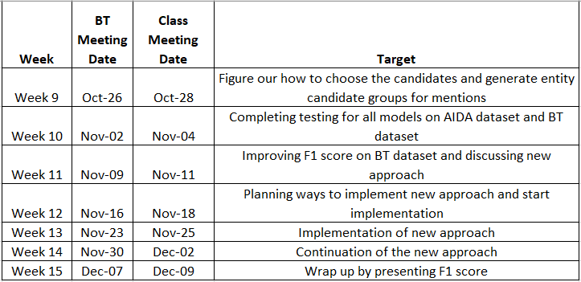
Plans
Implementation Timeline
Notes:
in the upcoming weeks we will implement the final models for the company’s dataset and see if we can get a better micro f1 score

Slide 37
Thank you!
Any Questions?

